Slide 1

employee payroll Management
System
Batch-1

Slide 2

Batch -01
Front End and Backend :
R. Nodankumar 2564563
U. Dasaratha Rami Reddy 2562947
B. Mahesh 2563697
P. TejasRi 2564180
K. V. PraneetHa 2563138
T. Sravya 2563373
B. Anitha 2563568
Soumi Datta 2563944

Slide 3

Contents
Introduction
Objective
Tools & Languages Used
Features of Employee Payroll Management System
Advantages
App Flow
E-R Diagram
Screen Shots Of Output and details
Conclusion

Slide 4
Introduction
Employee payroll management system is an Internet-based Java application that automates the working of a company or work center that manage and maintain records of the employees in the different department.
The proposed project “Employee Payroll Management System” has been developed to overcome the problems faced in the practicing of manual system.
This web application is reduced as much as possible to avoid errors while entering data. It also provides error message while entering invalid data.

Slide 5
objective
The Primary objective of the design is to deliver the requirement as delivered by the feasibility report. There are some objective we kept in mind.
Practically : The system is quite stable and can be operated by the Employees with average intelligence.
Efficiency : We tried to involve accuracy, timeliness and comprehensiveness of system output.

Slide 6
Tools & Languages
Front End:
Visual Studio
Angular
HTML
CSS
BOOTSTRAP
Back End
Spring Tool Suite
MySQL
Hibernate
Postman

Slide 7
Features of Employee Payroll Management System
Easy to use.
It is completely secure.
This system is easily compatible with most of the web browsers.
Admin can view all the records whenever necessary with ease.

Slide 8
Advantages
Helps the employee easy way to access their data.
The information related to employee can be added , edited, removed easily.
Store the end-to-end data of the employees

Slide 9
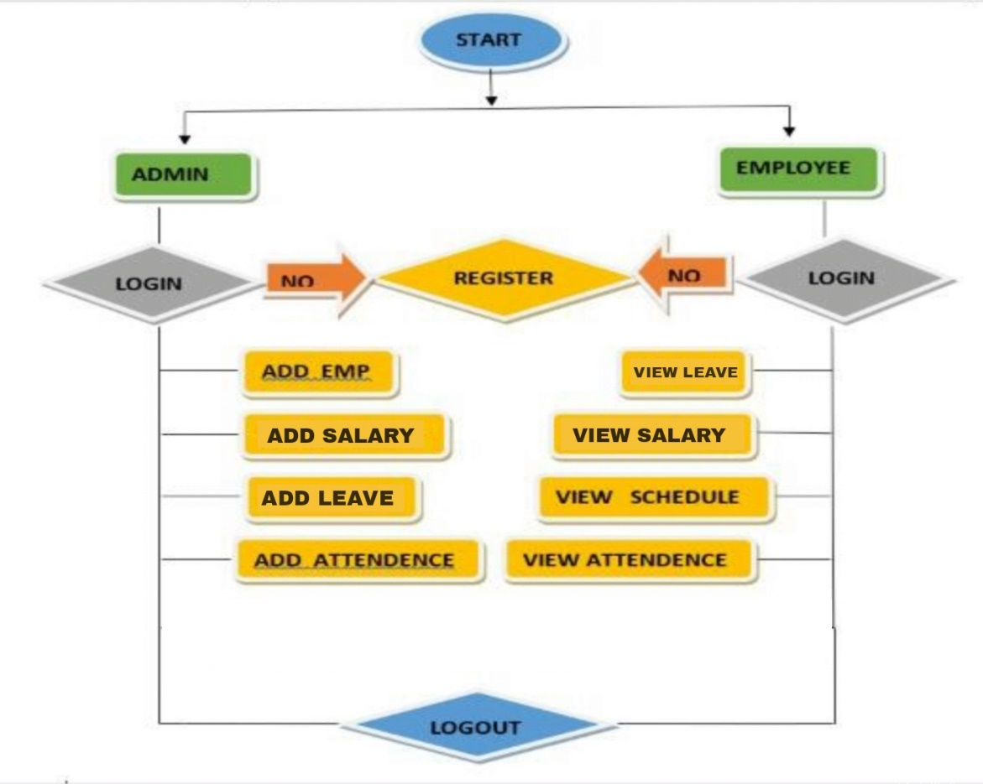
App Flow:

Slide 10
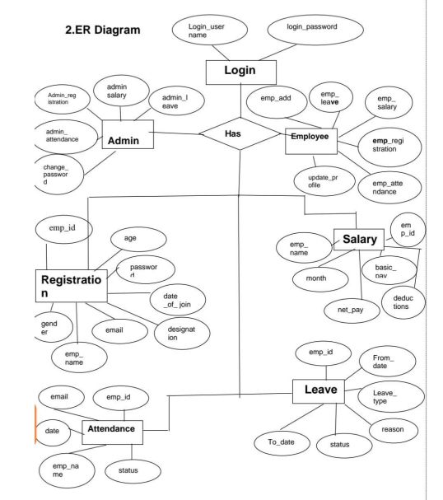
E-R Diagram:

Slide 11
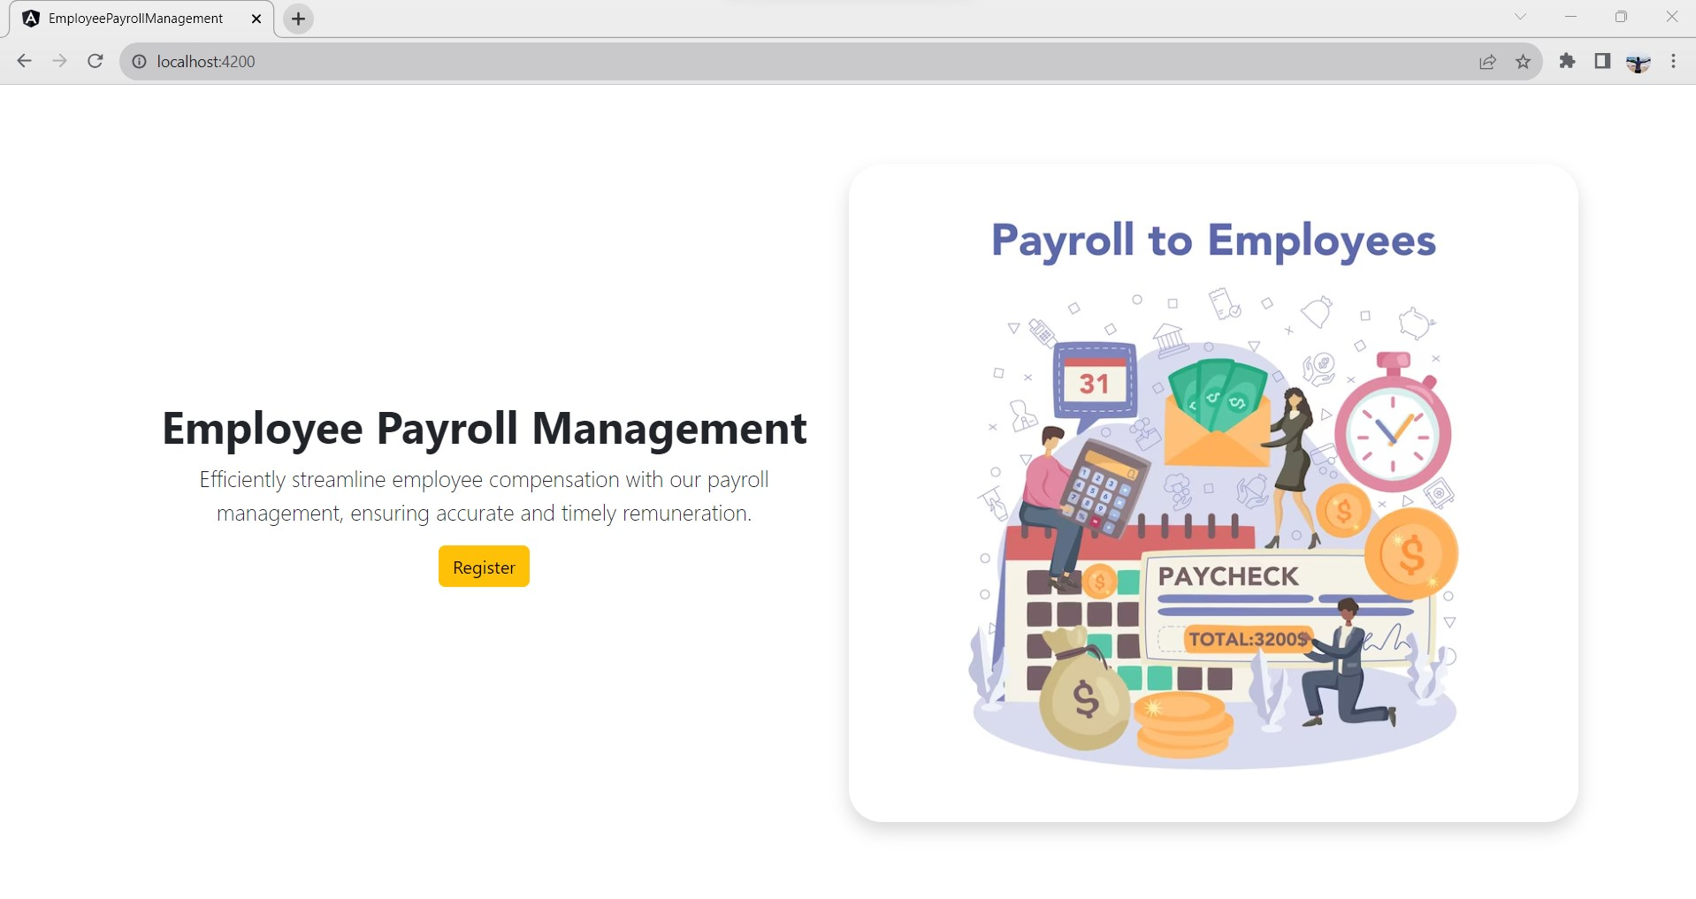
Home Page:
Screenshots Of Output and Details

Slide 12
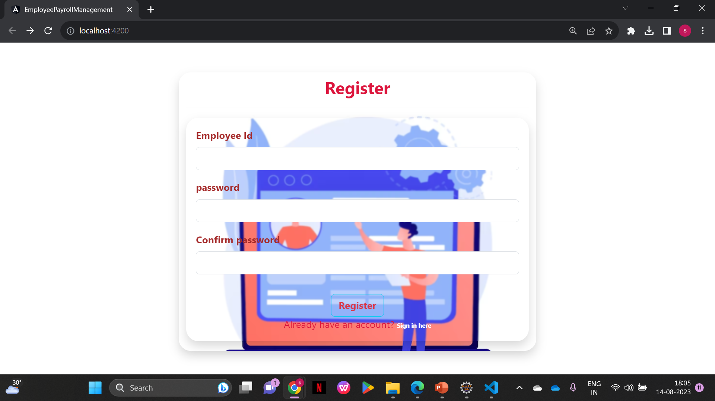
Register Page:

Slide 13
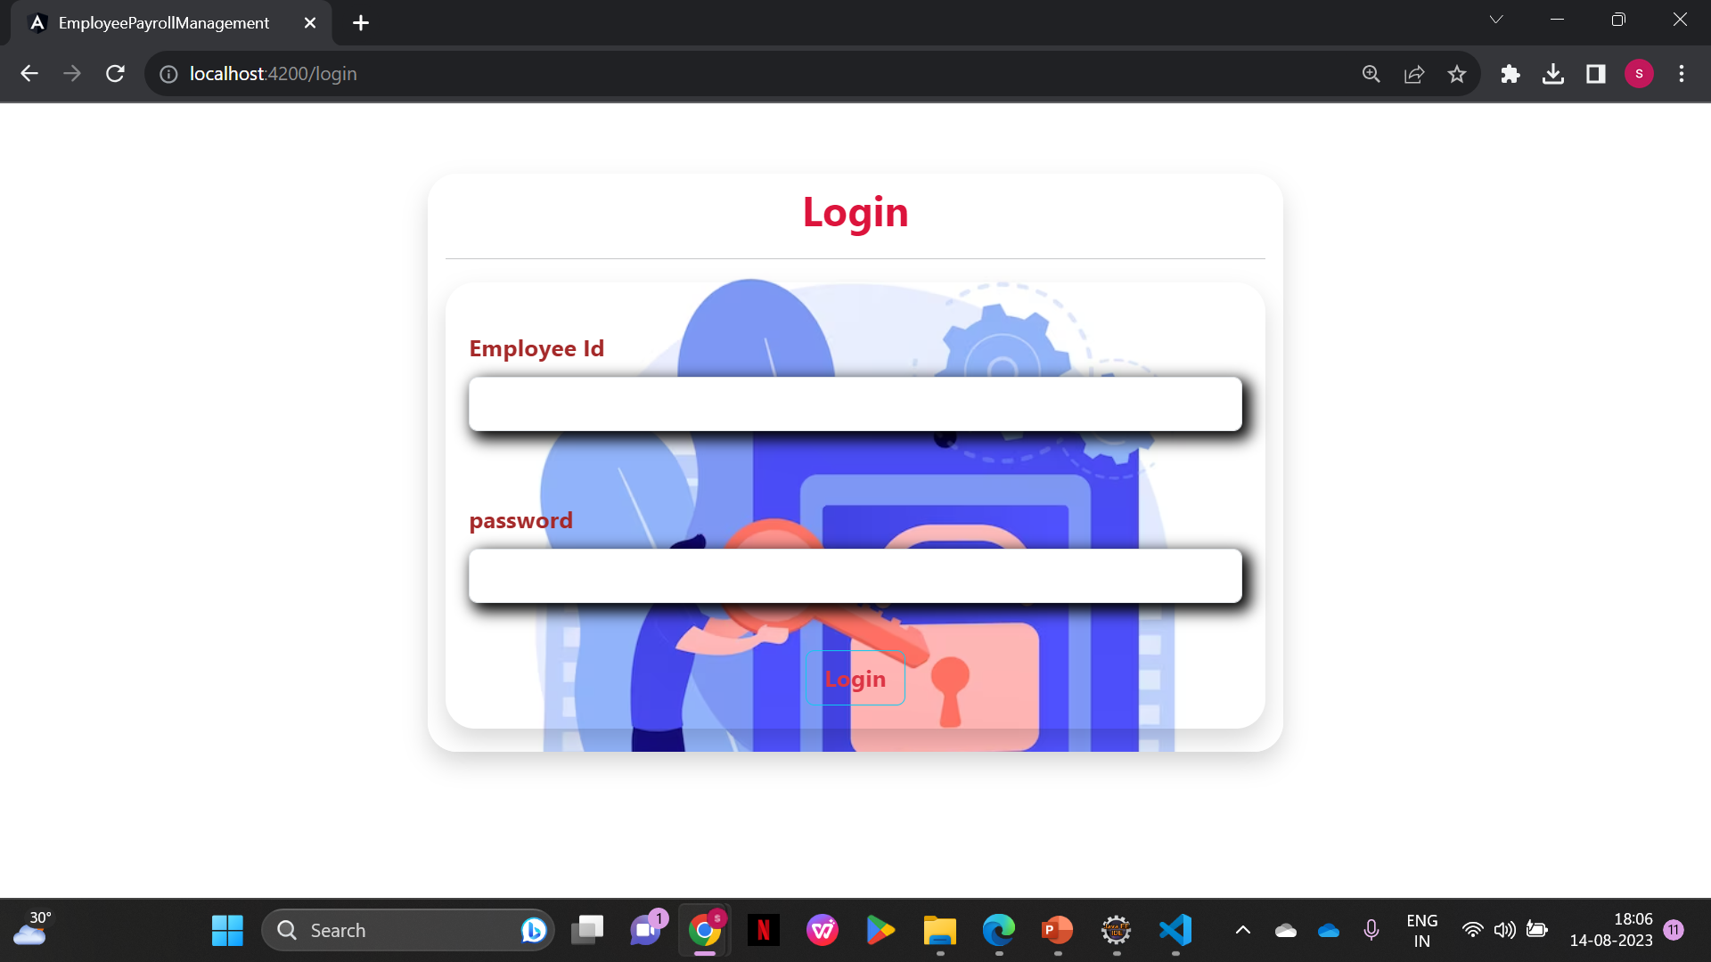
Login Page:

Slide 14
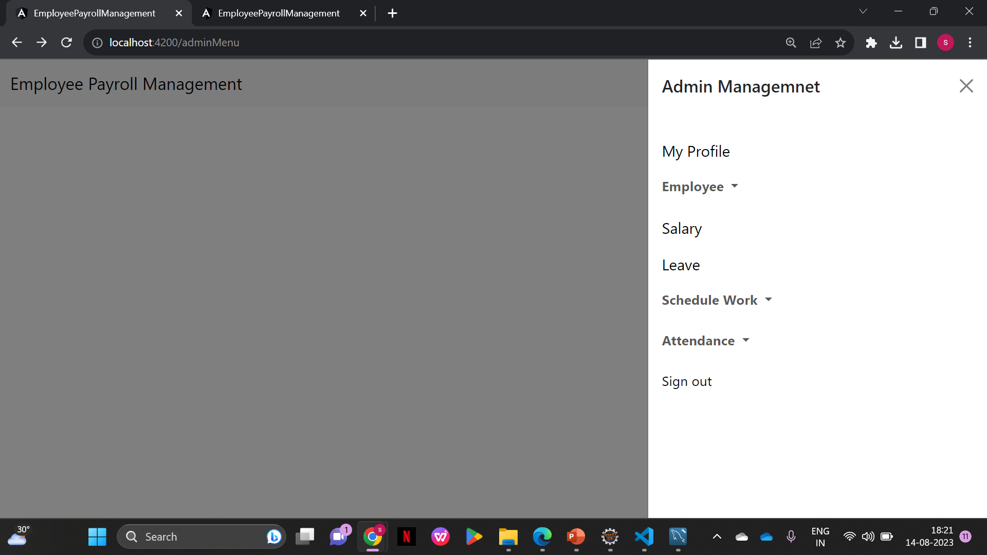
Admin Page:

Slide 15
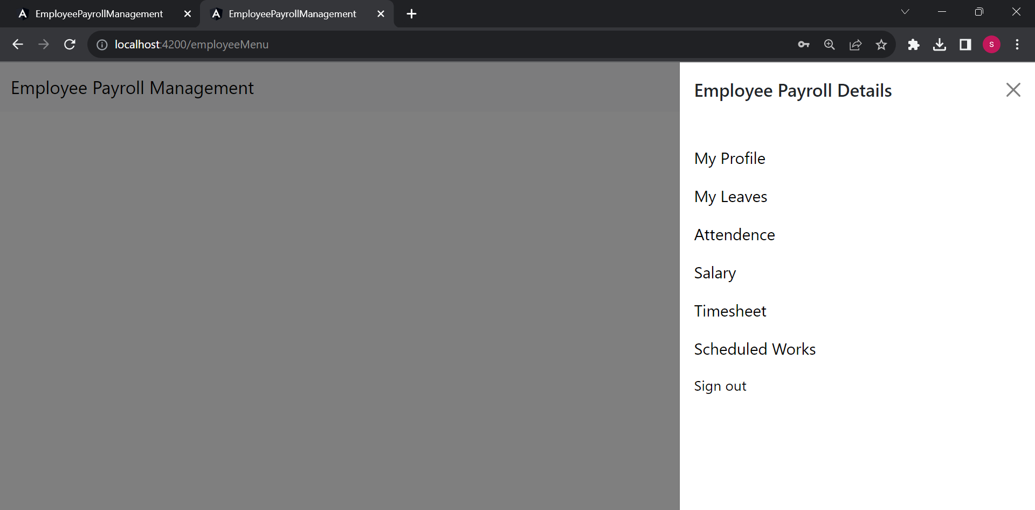
Employee Page:

Slide 16

Update Profile
Update profile :The admin and employee can view and update the profile.

Slide 17

Add/Edit/Delete and View Employees
Add : Expanding your team? Adding new members is straightforward—just fill in the details.
Edit : Roles change? You can easily update employee information to reflect their current roles.
Delete : If circumstances change, removing employee records is hassle-free, keeping everything accurate.
View : Get a quick overview of your workforce to stay organized and manage effectively.

Slide 18

Add/Edit/Delete and View Schedule work of Employees
Streamline employee schedule management with our user-friendly system.
Effortlessly add, update, and delete schedules as required, ensuring smooth operations.
Gain a comprehensive view of work schedules, promoting optimal coordination.
Simplify workforce management and enhance productivity with ease.

Slide 19

Apply/Edit/Delete and View Leaves of Employees
Apply: Adding leave records for employees is a breeze. Just input the dates and reason, and you're all set!
Edit: Need to make changes to leave dates? No problem! Easily edit leave records to match the new plans.
Delete: Plans changed? You can delete leave entries without any hassle, ensuring accurate records.
View: Get a quick overview of who's on leave and when. Stay organized and plan ahead effectively.

Slide 20

Mark/Edit/Delete Attendance of Employees
Mark: Recording employee attendance is a breeze. Just input the dates they worked, and you're good to go!
Edit: Made a mistake in the attendance log? No problem! Easily edit attendance records to match the accurate hours.
Delete: Things change? You can remove attendance entries hassle-free, keeping records spot on.
.

Slide 21

View attendance of Employees
View: Need to know who was present and when? Get a quick snapshot of attendance to stay organized and plan effectively

Slide 22

Add/Edit/Delete Salary of Employees
Add: Managing employee salaries is a breeze. Just input the details, and you're all set!
Edit: Need to make changes to salary figures? No problem! Easily edit salary records as needed.
Delete: Situations change? You can remove salary entries hassle-free, keeping records accurate.

Slide 23
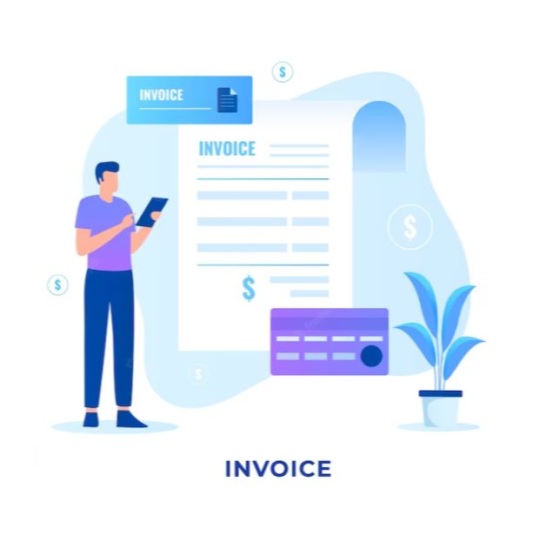
View and Download Salary slips of Employees
View: Checking your salary details is hassle-free. Just a click away, and you can see your earnings.
Download: Need a copy? You can download your salary slip anytime you want.
User-Friendly: Our system is designed to make accessing salary slips simple and intuitive.
Self-Service: Empower employees by allowing them to access their own salary information.

Slide 24
Conclusion
Our Project in a Nutshell:
This project is designed for both admin and employees in small organizations. It's perfect for workplaces with a limited number of team members. The admin has the power to add, update, and remove employee information. They can also handle adding new employees and setting pay grades. Admins can easily check records whenever they need to, with payment being on a monthly basis.
The project aims to make things easy and accurate. It saves time, cuts costs, and helps manage records effectively. It's a simple way to streamline processes and keep everything running smoothly.

Slide 25


